Slide 1

C# Tips and Tricks
SoftUni Team
Technical Trainers
Software University
http://softuni.bg

Slide 2
Table of Contents
Traps
Syntactic Sugar and Language Features in C#
Useful .NET Classes and Methods
Debugging and Testing Tips
Demos: https://github.com/NikolayIT/CSharp-Tips-and-Tricks

Slide 3
Have a Question?
sli.do
#csharp-masterclass

Slide 4

Traps

Slide 5
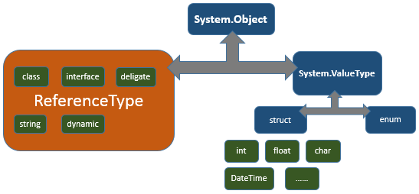
Equality in .NET
Value equality
The generally understood meaning of equality
Two objects contain the same values
E.g. two integers with the same value have value equality
Reference equality
Also known as identity
Two object references refer to the same object

Slide 6
Check References in .NET
To check for reference equality, use ReferenceEquals (returns Boolean)
To check for value equality, you should generally use Equals
Equals as it is implemented by Object just performs a reference check (we should override it)
By default, the operator == tests for reference equality (override it for immutable types)
object.ReferenceEquals(firstObject, secondObject)
firstObject.Equals(secondObject) // true or false
firstObject == secondObject // true or false

Slide 7
Comparing Structs
All structs derive from the same ValueType class
ValueType.Equals(Object) method overrides Object.Equals(Object) and provides the default implementation of value equality
By default when comparing structs with Equals()
If none of the fields of the current instance are reference types => byte-by-byte comparison
Otherwise it uses reflection to compare the corresponding fields (~20 times slower!)
We can improve the performance of structs by comparing them with overridden Equals

Slide 8
String References
String is a reference and immutable type
The CLR uses a method of storing only one copy of each distinct string value (string interning)
When apply += operator a new pointer to new string is created
Use StringBuilder for string manipulations
var string1 = "some value";
var string2 = "some value";
// ReferenceEquals(string1, string2) is true
var stringFromConsole = Console.ReadLine(); // "some value"
// ReferenceEquals(string1, stringFromConsole) is false
var stringIntern = string.Intern(stringFromConsole);
// ReferenceEquals(string1, stringIntern) is true

Slide 9
Preserving Stack Trace
These two same blocks simply re-throw the current exception keeping the stack trace:
The next block is different:
It will change the source and the stack trace
It will appear that the exception has been thrown from the current method from that very line
Prefer creating new custom exceptions
try { … } catch () { throw; }
try { … } catch (Exception e) { throw; }
try { … } catch (Exception e) { throw e; }

Slide 10
Exceptions & Static Constructors
A static constructor is called automatically to initialize the class before:
The first instance is created
Or any static members are referenced
Once a type initializer has failed, it is never retried (for the lifetime of the AppDomain)
Type will remain uninitialized
Creating instances will also fail
You should have a very good reason for throwing an exception from a static constructor

Slide 11
Virtual Call In Constructor
Calling virtual methods in a constructor is a bad idea
When initializing a type in C#, constructors are invoked top-down
First the top base constructor (object())
Then down to the derived constructors through the inheritance
But virtual methods are invoked bottom-up
First the most derived overridden method
Then up to all base virtual methods
For this reason, if you call virtual methods in constructor, you may have unexpected behavior from your classes

Slide 12
Changing Hash Code Run-time
Hash code is used in various hash-based collections (HashSet<T>, Dictionary<TKey, TValue>)
In C# an overridden method named GetHashCode provides the hash code generation for a particular type
If you generate a custom hash code for a type, try to use read-only properties for it
Non-read-only properties may change the hash code run-time and collections will not be notified for the change
Thus the internal structure and algorithms of the collection will not be able to retrieve and use the modified instance

Slide 13
Random Numbers in .NET
The Random class in .NET is a pseudo-random number generator (deterministic)
Any instance of Random has a certain amount of state (their seed value initially), also:
RNGCryptoServiceProvider generates high-quality random numbers
csharpindepth.com/Articles/Chapter12/Random.aspx
// These two instances will generate the exact same values
var firstRandomNumbersGenerator = new Random(0);
var secondRandomNumbersGenerator = new Random(0);

Slide 14
LINQ Multiple Enumeration
Consider the following code snippet
We are doing extra work by enumerating the collection twice in the two foreach statements
If GetDataObjects() results in a DB query, we are executing the query twice with the same result
Can be fixed by forcing the enumeration with call to .ToList() method after GetDataObjects()
IEnumerable<DataObject> dataObjects = GetDataObjects();
foreach (var dataObject in dataObjects)
Console.WriteLine(dataObject);
var allObjectsAsString = new StringBuilder();
foreach (var dataObject in dataObjects)
allObjectsAsString.Append(dataObject + " ");

Slide 15
Memory Leaks in .NET
The .NET runtime employs a very smart garbage collector to clean up objects that are no longer used
This doesn't mean that you'll never lose track of memory
Not removing event listeners
Any event listener that is created with an anonymous method or lambda expression that references an outside object will keep those objects alive
Keeping db connections or result sets open, when they are not used
Call to functions using P/Invoke which allocate memory which you then never release

Slide 16

Syntactic Sugar
Language Features in C#

Slide 17
Casting vs the 'as' Operator
When casting from one type to another fails, the CLR will throw an exception
When using the 'as' operator, in case of fail, no exception will be thrown but the value will be null
The 'is' operator can check the type of a variable
object str = "Five";
var num = (int?)number; // InvalidCastException
// The next line will be evaluated without exception
var numberAsInt = number as int?;
// Here numberAsInt will be null because the cast is invalid

Slide 18
Combinable Enum Values
Enums can store a combination of different values called bit-flags
Standard enums can only support one value
[Flags] allow us to have combination of values
[Flags]
public enum Margins
{
None = 0, Top = 1, Left = 2, Bottom = 4, Right = 8,
}
var bottomRight = Margins.Bottom | Margins.Right; // 8+4=12
bottomRightMargin == Margins.Bottom; // False
bottomRightMargin.HasFlag(Margins.Bottom); // Тrue

Slide 19
Optional Parameters
Optional parameters enable us to omit arguments for some method parameters
The default value has to be a constant, parameterless constructor of a value type or default(T) for some type T
When using them, we should note that the default value is embedded in the caller's assembly
If we change the default value without rebuilding the calling code, we'll still see the old value
BankAccount(string accountHolder, decimal money = 1000) { … }

Slide 20
Using yield
Using yield to define an iterator removes the need for an explicit extra class when implementing the IEnumerable
We use it in methods that return the type IEnumerable or IEnumerable<T>
IEnumerable<int> EvenNums(int from, int to)
{
for (int i = from; i <= to; i++)
if (i % 2 == 0)
yield return i;
}
foreach (var n in EvenNums(51, 60))
{ Console.WriteLine(n);
}

Slide 21
Constraining Generics
In generic classes, we can apply restrictions to the type arguments:
The type argument must be or derive from the specified base class or interface
The type argument must be a reference type (class) or a value type (struct)
The type argument must have a public parameterless constructor
class TemplateClass<T>
where T : SomeClass
class TemplateClass<T>
where T : class // where T : struct
class TemplateClass<T> where T : new()

Slide 22
Covariance and Contravariance
A generic type parameter can be one of:
Invariant (default) – meaning the generic type parameter cannot be changed
Contravariant – the generic type parameter can change from a class to a class derived from it
In C# we indicate this with the in keyword
Can appear only in input positions (method’s argument)
Covariant – the generic type argument can change from a class to one of its base classes
In C# we indicate this with the out keyword
Can appear only in output positions (method’s return type)

Slide 23
More Syntactic Sugar
?: - ternary operator + chaining
Partial classes and methods?
Short initializing of arrays = { 1, 2, 3 }
Extern alias for resolving namespace conflicts
params for arbitrary number of parameters
Custom Indexers public string this[string int]

Slide 24
More Syntactic Sugar (2)
Omit generic type when call method X<T>(y)
Multicast delegates (+=, -=) + Equality of delegates
@keyword for variable and class naming
public static explicit operator MyEntity
Hide Interface Implementation

Slide 25

Useful .NET Classes and Methods

Slide 26
The Tuple Class
A Tuple is a generic data structure that has a specific number and sequence of elements with overrided Equals, ToString, GetHashCode
Each element can have any type (e.g. int, tuple)
Tuples are immutable (read-only)
Tends to provide low-quality code
Useful for private methods (params and return values) and composite keys in dictionaries
var dataObject = new Tuple<int, decimal>(4, 2.5);
Console.WriteLine("First value: {0}", dataObject.Item1);
Console.WriteLine("Second value: {0}", dataObject.Item2);

Slide 27
C# 7.0 Tuples
C# 7 tuples are types that you define using a lightweight syntax
Preferred over the Tuple<> class (better code quality)
They are structs (i.e. value types)
They can have meaningful names for their fields
public (int Count, decimal Average) GetCountAndAverage(…)
{
return (3, 2.5M);
}
// var result = GetCountAndAverage();
// result.Count
// result.Average

Slide 28
Method Deprecation
The [Obsolete] attribute in .NET marks a method that is about to be removed in future versions (a deprecated method)
The attribute generates a compiler warning
We can also generate a compiler error
It is a good practice to specify the new routine that has to be used in the message
[Obsolete("CreateXml() method is deprecated. Use CreateXmlReader instead.", false)] // true for error
public void CreateXml () { }

Slide 29
File System Watcher
The System.IO.FileSystemWatcher class makes it possible to execute code when certain files or directories are created, modified, or deleted
It listens to the file system change notifications and raises events
Few things to consider:
Sometimes events may be raised multiple times
The watcher will continue listening until the EnableRaisingEvents is set to False
More: http://weblogs.asp.net/ashben/31773

Slide 30
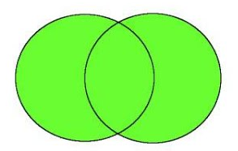
Homogeneous Combinations
Concat() – concatenates sequences
Order of which sequence comes first matters
Union() – concatenate sequences without duplicates
Duplicates are determined by using an IEqualityComparer<T> or Equals() + GetHashCode()
firstList = { "apples", "bananas", "cherries", "durian" };
secondList = { "durian", "eggplant", "apples" }
PrintList(firstList.Concat(secondList));
// apples,bananas,cherries,durian,durian,eggplant,apples
PrintList(firstList.Union(secondList));
// apples, bananas, cherries, durian, eggplant

Slide 31
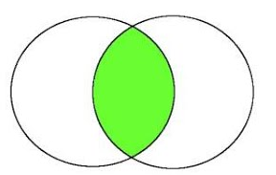
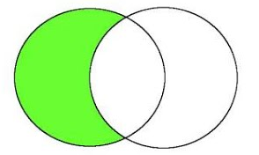
Homogeneous Combinations (2)
Intersect() – subset of each collection that is found in both collections (i.e. common elements)
Except() – subtracts elements from a collection (i.e. first collection minus second one)
Both Intersect() and Except() depend on Equals() + GetHashCode() or IEqualityComparer<T>
firstList = { "apples", "bananas", "cherries", "durian" };
secondList = { "durian", "eggplant", "apples" }
PrintList(firstList.Intersect(secondList)); // apples, durian
PrintList(firstList.Except(secondList));
// bananas, cherries

Slide 32
Heterogeneous Combinations
Zip() – for each elements: combines element from the first sequence an with element from the second sequence using result selector function
Aggregate() – Applies an accumulator function over a sequence
Built-in: Count, Min, Max, Sum and Average
listOfNumbers = Enumerable.Range(1, 4);
firstList = { "apples", "bananas", "cherries", "durian" };
PrintList(listOfNumbers.Zip(firstList, Tuple.Create));
// (1, apples), (2, bananas), (3, cherries), (4, durian)
Console.WriteLine(firstList.Aggregate((s, c) => s + c)));
// applesbananascherriesdurian

Slide 33

Debugging and Testing Tips

Slide 34
Test Internal/Private Members
Eas­i­est way out is to make the members pub­lic
Make the members pro­tected and have the unit test class extend this class to gain access
Use reflec­tion to invoke the members
Use Inter­nalsVis­i­bleTo for internal members
Use PrivateObject class for private members (.NET Framework only)
[assembly: InternalsVisibleTo("ExposeInternals.Tests")]
var summator = new Summator();
var privateObject = new PrivateObject(summator);
var getZeroValue = privateObject.Invoke("GetZero");

Slide 35
Debugger Variable Display
Control how debugger variables look like
When overridden, ToString is used in the debugger variable windows for classes
DebuggerDisplay controls how a class or field is displayed in the debugger variable windows
DebuggerBrowsable determines if and how a member is displayed in the debugger variable windows (values: Never, RootHidden)
[DebuggerDisplay("Student named {FirstName} {LastName}")]
[DebuggerBrowsable(DebuggerBrowsableState.RootHidden)]

Slide 36
Caller Info Attributes
Inject code properties during compile-time
CallerMemberName attribute will inject the name of the method/property that is calling the method
CallerFilePath attribute will inject the file path of the code file in which the caller is located
CallerLineNumber attribute will inject the line number in the code file, in which the caller is located
GetCallerMemberName([CallerMemberName]string memberName = null)
GetCallerFilePath([CallerFilePath]string filePath = null)
GetCallerLineNumber([CallerLineNumber]int lineNumber = 0)

Slide 37
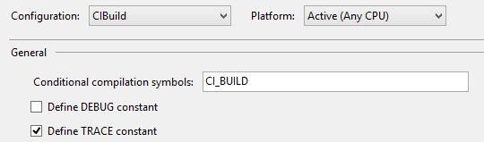
Preprocessor Symbols
Conditional compilation directives make it easy to build varying versions of an application by varying the preprocessor symbols
#if, #elif, #else and #endif control the conditional code execution
#if DEBUG
// Debug build
#elif CI_BUILD
// CI_BUILD is set
#else
#error Neither DEBUG nor CI_BUILD
#endif

Slide 38
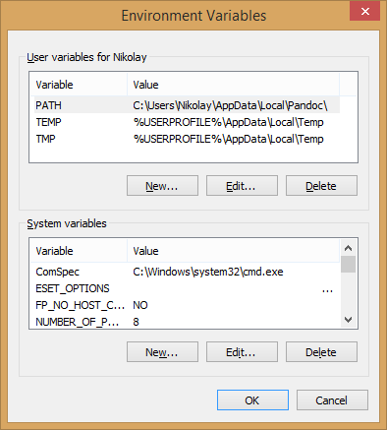
Current System Information
We can use the System.Environment class for gathering the current system information
// Get the current directory for the process
var currDir = Environment.CurrentDirectory;
// Get platform independent system directory path
Environment.GetFolderPath(Environment.SpecialFolder.Fonts)
// New line "\r\n" for non-Unix and "\n" for Unix plaforms
var currentPlatformNewLine = Environment.NewLine;
// Get logical drives (hard disk partitions)
var strArr = Environment.GetLogicalDrives();
// Get Current stack trace
var stackTrace = Environment.StackTrace;
// Get environment variables value
Environment.GetEnvironmentVariable("Path")

Slide 39

Summary
Traps
Syntactic Sugar and Language Features in C#
Useful .NET Classes and Methods
Debugging and Testing Tips
…
…
…

Slide 40
https://softuni.bg/trainings/courses

Slide 41












SoftUni Diamond Partners

Slide 42




SoftUni Organizational Partners

Slide 43




Trainings @ Software University (SoftUni)
Software University – High-Quality Education and Employment Opportunities
softuni.bg
Software University Foundation
http://softuni.foundation/
Software University @ Facebook
facebook.com/SoftwareUniversity
Software University Forums
forum.softuni.bg

Slide 44

License
This course (slides, examples, demos, videos, homework, etc.) is licensed under the "Creative Commons Attribution-NonCommercial-ShareAlike 4.0 International" license

